Slide 1
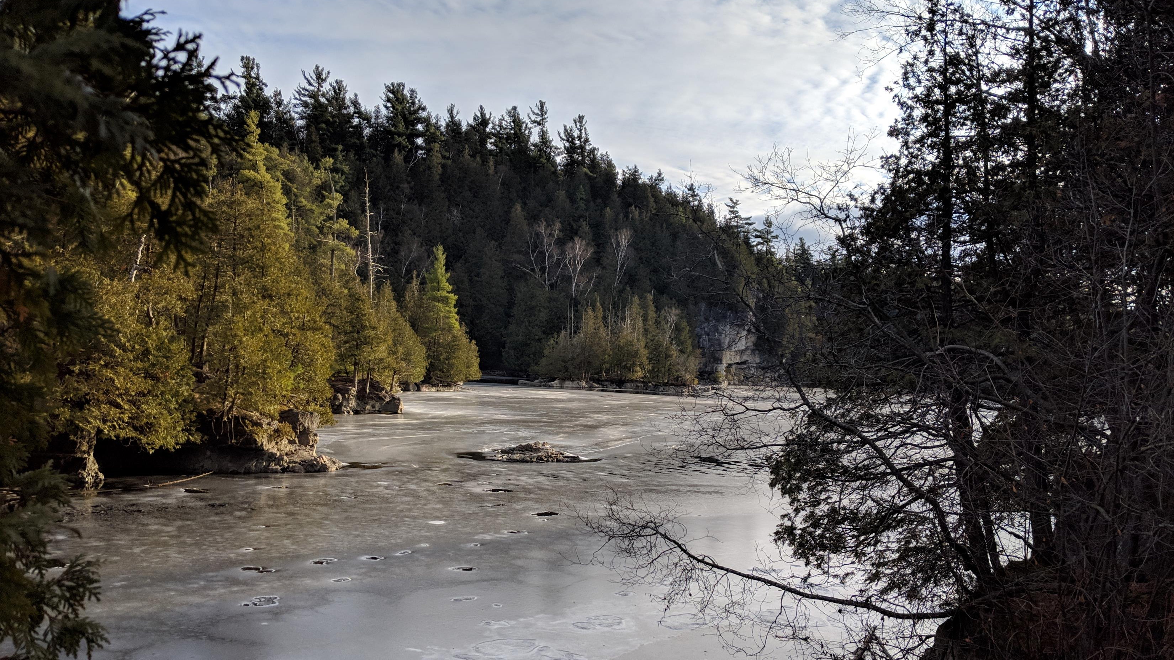
Generalized Linear Models (GLMs)
Dr. Alessandro Filazzola & Dr. Christopher Lortie
BIOL 5018

Slide 2
Outline & Learning Outcomes
Part A – Conducting GLMs
Describe the uses of GLMs relative to linear regression
Be able to conduct a GLM in R
Gain a basic understanding of the mechanics and outputs of a GLM
Part B – Prediction
Describe how GLMs can be used for predictions with new data
Explain the approach for optimizing predictions
Part C – Post-hoc analyses and mixed models
Understand the differences between GLMs and GLMMs
Explain the purpose of post-hoc analyses and when they may be used
Be able to conduct a GLMM and post-hoc analysis in R

Slide 3
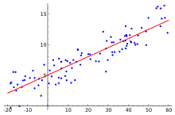
Generalized Linear Models (GLM)
Part A
General linear models = typical linear regression
Generalized Linear Models = distribution + link function
Poisson regression
Negative binomial regression
Gamma regression
Zero-inflated regression
Logistic regression (sometimes referred to as binomial)
Notes:
A generalized linear model (GLM) is a statistical test that compares a response variable to a series of predictors. It shares a lot of similarities to typical ordinary least squares analyses such as linear regression, ANOVAs, and ANCOVAs. The major difference and the reason why it is so appealing to analysts is that GLMs can use non-normal data.

Slide 4
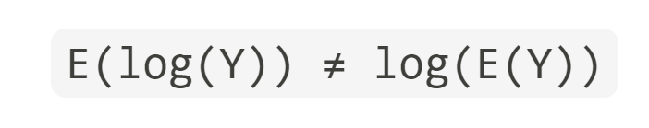
Why use a GLM?
The response variable is not normally distributed, or the range is restricted
The variance of the response variable depends on the mean
GLMs can fit to particular distributions without transformations. The benefits of this include i) the homogeneity of variance does NOT need to be satisfied and ii) the response variable does not need to be changed.

Slide 5
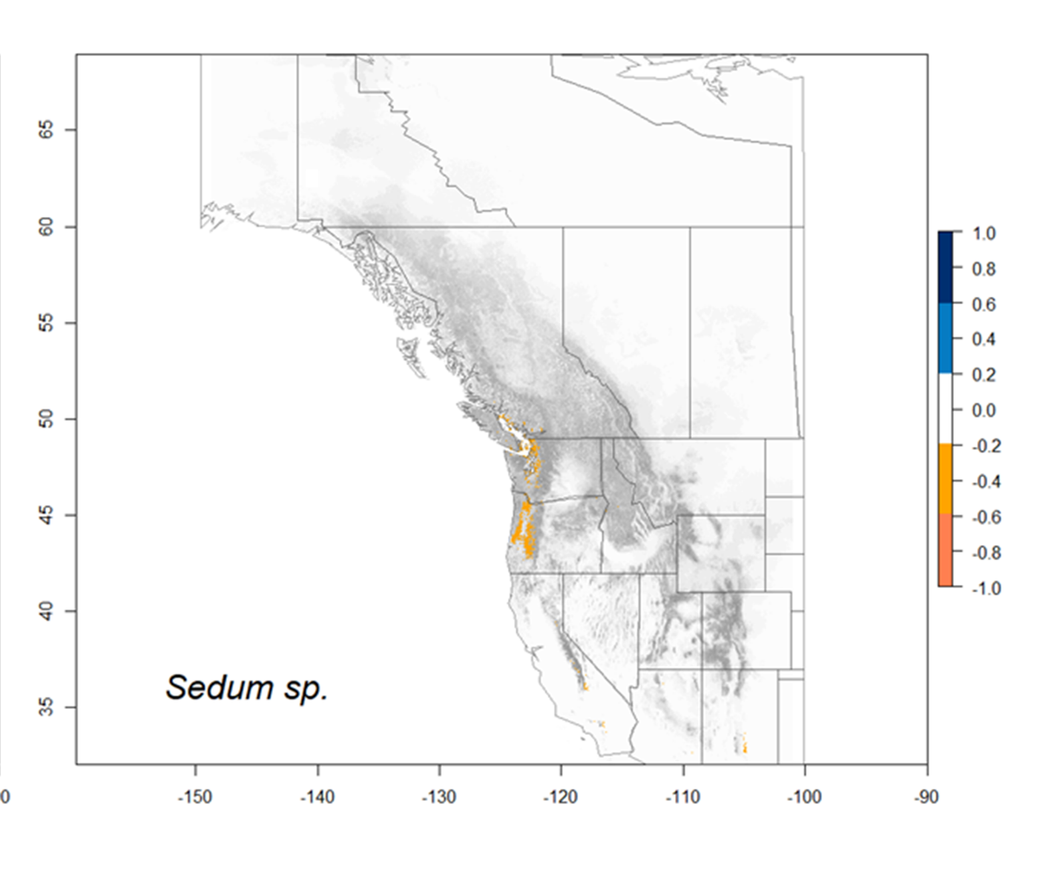
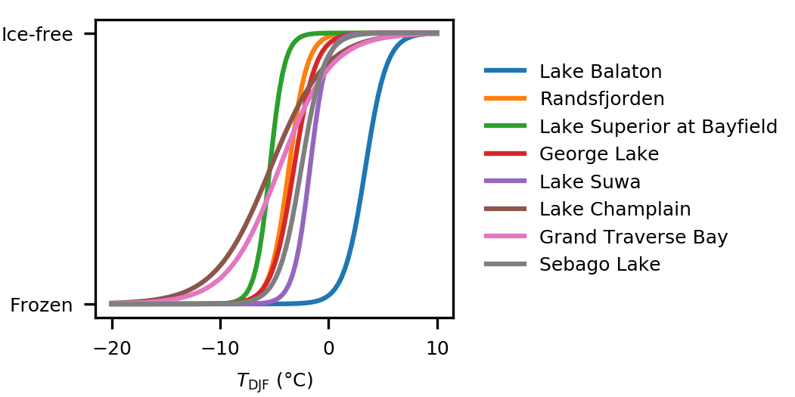
Examples of GLMs
Used frequently to test and predict

Slide 6

Parallels with linear regression
Both logistic and linear regression can:
Test for significance of a predictor
Calculate an effect size
Use continuous or categorical predictors
Can predict values for new values

Slide 7

Differences with linear regression
Logistic regression differs from linear regression in that:
Response variable can be complex (e.g., binary, discrete, continuous)
There is no “true” R2 or residuals
Uses Maximum Likelihood instead of Sum of Squares

Slide 8
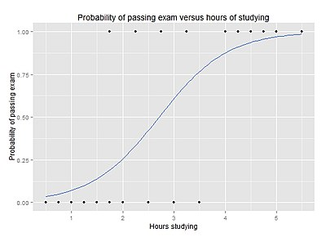
Understanding GLMs
Fitting a line
The outputs
Calculating fit
Wikimedia.com

Slide 9
1) Fitting a line: linear regression
Sum of squares minimizes residuals

Slide 10
1) Fitting a line: logistic regression
1
Lake Ice-free
0
-10
2
Winter Air Temperature (°C)

Slide 11
1) Fitting a line: logistic regression
1
Lake Ice-free
0
-10
2
Winter Air Temperature (°C)

Slide 12
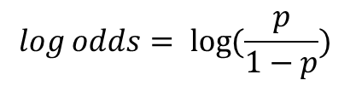
Question
1
Are these asymptotes or to they plateau at 1 and zero respectively?
Lake Ice-free
$$\log{odds= \log{(\frac{p}{1−p})}}$$
0
-10
2
Winter Air Temperature (°C)

Slide 13
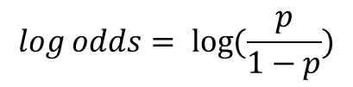
1) Putting the linear in generalized linear model
1
Lake Ice-free
$$\log{odds= \log{(\frac{p}{1−p})}}$$
0
-10
2
Winter Air Temperature (°C)

Slide 14
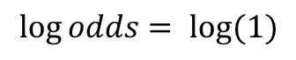
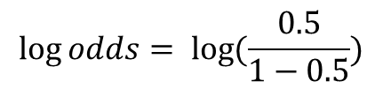
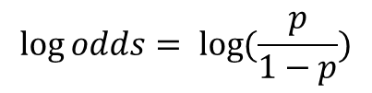
1) Putting the linear in generalized linear model
1
$$\log{odds= \log{(\frac{p}{1−p})}}$$
$$\log{odds= \log{(\frac{0.5}{1−0.5})}}$$
Lake Ice-free
$$\log{odds= \log{(1)}}$$
0
-10
2
This is the slope co-efficient from the R Output
Winter Air Temperature (°C)

Slide 15
1) Putting the linear in generalized linear model
1
$$\log{odds= \log{(\frac{p}{1−p})}}$$
Lake Ice-free
0
-10
2
Winter Air Temperature (°C)

Slide 16
1) Putting the linear in generalized linear model
?
1
$$\log{odds= \log{(\frac{p}{1−p})}}$$
Lake Ice-free
0
-10
2
Winter Air Temperature (°C)

Slide 17
1) Fitting the model
1
Multiply the probability
Lake Ice-free
0
-10
2
Winter Air Temperature (°C)

Slide 18
1) Fitting the model – maximum likelihood
1
Lake Ice-free
0
-10
2
Winter Air Temperature (°C)

Slide 19
1) Fitting the model – maximum likelihood
1
Lake Ice-free
0
-10
2
Winter Air Temperature (°C)

Slide 20
1) Fitting the model – maximum likelihood
1
Lake Ice-free
0
-10
2
Winter Air Temperature (°C)

Slide 21
1) Fitting the model – maximum likelihood
1
Maximum likelihood optimizes quickly
Lake Ice-free
0
-10
2
Winter Air Temperature (°C)

Slide 22
2) The outputs – GLMs in R

Slide 23
3) Calculating a measure of fit
Typical linear regression uses R2
No R2 in logistic regression because no residuals
Instead use Psuedo R2
McFadden’s among the simpler compares to null

Slide 24
3) Calculating a measure of fit
1
1
Multiply the probability
Multiply the probability
Null Maximum Likelihood
Model Maximum Likelihood
Lake Ice-free
0
0
-10
2
-10
2
Winter Air Temperature (°C)
Winter Air Temperature (°C)

Slide 25
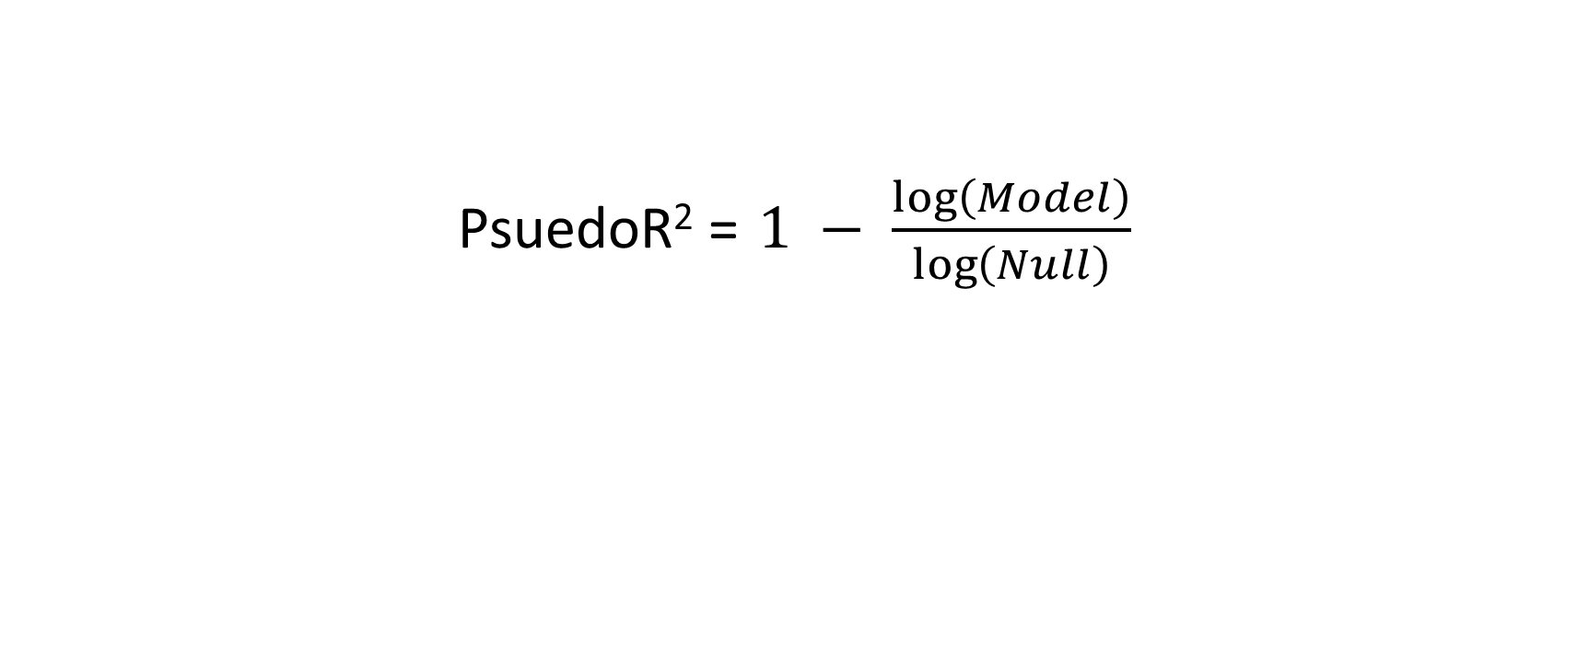
3) Calculating a measure of fit
PsuedoR² = $1 − \frac{\log\left(Model\right)}{\log\left(Null\right)}$
m3<- glm(icefree~temperature, family="binomial", data=iceData)
m3null<- glm(icefree~1, family="binomial", data=iceData)
1-logLik(m3)/logLik(m3null)

Slide 26
Prediction
Part B
1
Models probability
..but the outcome is binary
Need to identify a threshold
Lake Ice-free
0
-10
2
Winter Air Temperature (°C)

Slide 27
Prediction
1
0.5
Lake Ice-free
0
-10
2
Winter Air Temperature (°C)

Slide 28
Prediction
1
False Positive
Lake Ice-free
0.35
0
-10
2
Winter Air Temperature (°C)

Slide 29
Prediction
1
0.65
Lake Ice-free
False Negative
0
-10
2
Winter Air Temperature (°C)

Slide 30
Question
When is an example where you would like to reduce false negative rate at the expensive of false positive?
Predicting infection of a disease
Understanding climate effects on lake ice
Predicting the probability of a species occurring
A and C
All the above

Slide 31
Prediction – confusion matrix
1
 | Actual Positive | Actual Negative
Predicted Positive
Predicted Negative
Lake Ice-free
True positive
False positive
False negative
True negative
0
-10
2
Winter Air Temperature (°C)

Slide 32
Prediction – confusion matrix
1
 | Actual Positive | Actual Negative
Predicted Positive
Predicted Negative
0.5
Lake Ice-free
0
-10
2
Winter Air Temperature (°C)

Slide 33
Prediction – confusion matrix
1
 | Actual Positive | Actual Negative
Predicted Positive
Predicted Negative
0.65
Lake Ice-free
0
-10
2
Winter Air Temperature (°C)

Slide 34
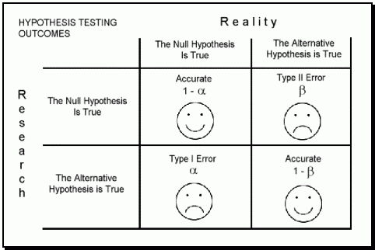
Prediction – confusion matrix
https://blog.datasciencedojo.com/

Slide 35
Optimizing the threshold
Many different methods
Receiver operator characteristic (ROC) often used to pick threshold
Area under the curve (AUC) of ROC used to compare models

Slide 36
Optimizing the threshold - ROC
50/50 chance
True Positive Rate
(Sensitivity)
False Positive Rate
(1 – specificity)

Slide 37
Optimizing the threshold - ROC
True positives
 | Actual Positive | Actual Negative
Predicted Positive
Predicted Negative
True positive rate =
Actual positives
True positive
False positive
True positives
True positive rate =
True positives + False negatives
False negative
True negative
Sensitivity

Slide 38
Optimizing the threshold - ROC
False positives
 | Actual Positive | Actual Negative
Predicted Positive
Predicted Negative
False positive rate =
Actual negatives
True positive
False positive
True positives
False positive rate =
False positives + True negatives
False negative
True negative
Specificity

Slide 39
Sensitivity vs. specificity
No disease
With disease
Increase sensitivity
Increase specificity
Frequency of individuals
Low
High
Blood pressure

Slide 40
Optimizing the threshold - ROC
1
Lake Ice-free
True Positive Rate
(Sensitivity)
0
-10
2
False Positive Rate
(1 – specificity)
Winter Air Temperature (°C)

Slide 41
Optimizing the threshold - ROC
1
Lake Ice-free
True Positive Rate
(Sensitivity)
0
-10
2
False Positive Rate
(1 – specificity)
Winter Air Temperature (°C)

Slide 42
Optimizing the threshold - ROC
1
Lake Ice-free
True Positive Rate
(Sensitivity)
0
-10
2
False Positive Rate
(1 – specificity)
Winter Air Temperature (°C)

Slide 43
Optimizing the threshold - ROC
1
Lake Ice-free
True Positive Rate
(Sensitivity)
0
-10
2
False Positive Rate
(1 – specificity)
Winter Air Temperature (°C)

Slide 44
Optimizing the threshold - ROC
1
Lake Ice-free
True Positive Rate
(Sensitivity)
0
-10
2
False Positive Rate
(1 – specificity)
Winter Air Temperature (°C)

Slide 45
Optimizing the threshold - ROC
1
Lake Ice-free
True Positive Rate
(Sensitivity)
0
-10
2
False Positive Rate
(1 – specificity)
Winter Air Temperature (°C)

Slide 46
Optimizing the threshold - ROC
Q: Which is the best?
1
Lake Ice-free
True Positive Rate
(Sensitivity)
0
-10
2
False Positive Rate
(1 – specificity)
Winter Air Temperature (°C)

Slide 47
Optimizing the threshold - ROC
Best
1
Lake Ice-free
True Positive Rate
(Sensitivity)
0
-10
2
False Positive Rate
(1 – specificity)
Winter Air Temperature (°C)

Slide 48
Optimizing the threshold - ROC
1
Lake Ice-free
True Positive Rate
(Sensitivity)
0
-10
2
False Positive Rate
(1 – specificity)
Winter Air Temperature (°C)

Slide 49
Comparing models - AUC
AUC = 0.85
AUC = 0.76
True Positive Rate
(Sensitivity)
False Positive Rate
(1 – specificity)

Slide 50
A note about overdispersion
Over dispersion when the variance exceeds the mean model fit
Frequent in ecology data

Slide 51
A note about overdispersion
1
Lake Ice-free
0
-10
2
Winter Air Temperature (°C)

Slide 52
A note about overdispersion
1
Adjust for this using a dispersion parameter
R - Quasi-binomial
Lake Ice-free
0
-10
2
Winter Air Temperature (°C)

Slide 53
How do logistic regressions relate to GLMs?
Use a link function to connect to a linear function
Use Maximum Likelihood rather than sum of squares
Allows for the flexibility in GLMs for many distributions

Slide 54
GLM using a normal distribution
Probability vs. Likelihood
Normal distribution
μ = 10 kg
σ = 3.5
2 kg
10 kg
18 kg
Biomass

Slide 55
GLM using a normal distribution
Probability vs. Likelihood
Normal distribution
μ = 10 kg
σ = 3.5
Pr (14) = ?
Pr (14) = 1.14
Pvalue = 0.25
2 kg
10 kg
18 kg
Biomass

Slide 56
GLM using a normal distribution
Probability vs. Likelihood
Normal distribution
μ = 10 kg
σ = 3.5
L (14) = ?
L(14) = 0.18
0.3
0.2
0.1
0
2 kg
10 kg
18 kg
Biomass

Slide 57
Maximum likelihood for normal distribution
Maximum likelihood = L(1) * L(2) * … L(i)

Slide 58
Maximum likelihood for normal distribution
Maximum likelihood = L(1) * L(2) * … L(i)

Slide 59
Maximum likelihood for normal distribution
Maximum likelihood = L(1) * L(2) * … L(i)

Slide 60
Maximum likelihood for normal distribution
Likelihood of observing data

Slide 61
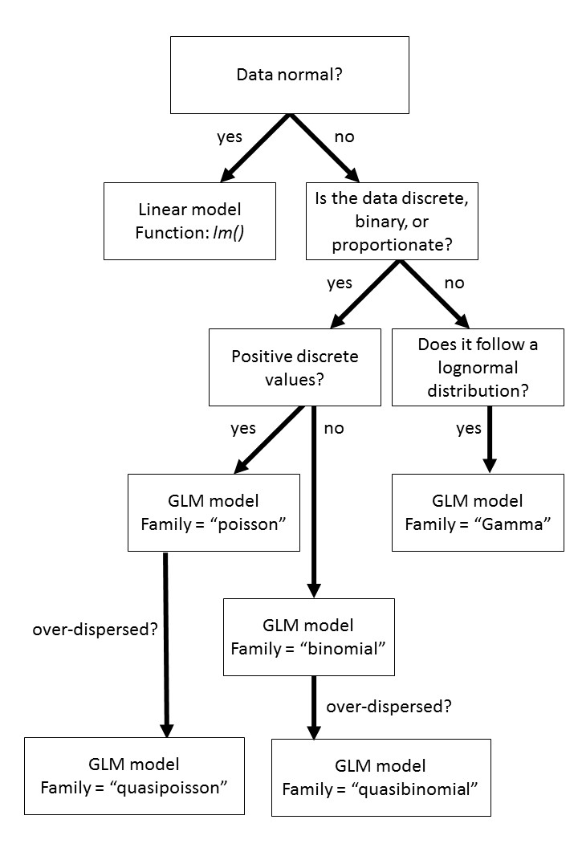
A simple workflow for GLMs

Slide 62
Case Study: Logistic regression to identify extreme events

Slide 63
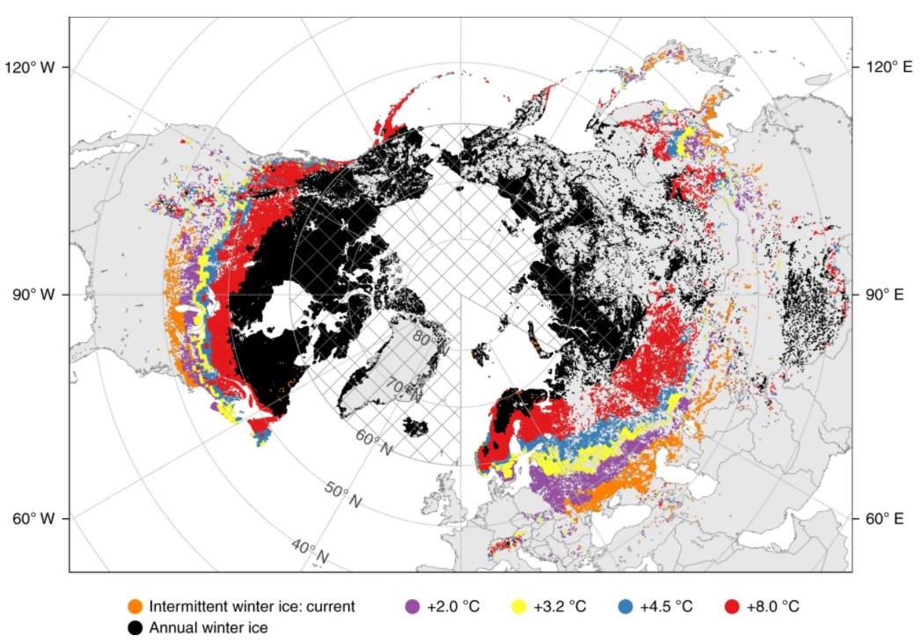
Lake ice is threatened by climate change
Sharma et al. 2019

Slide 64
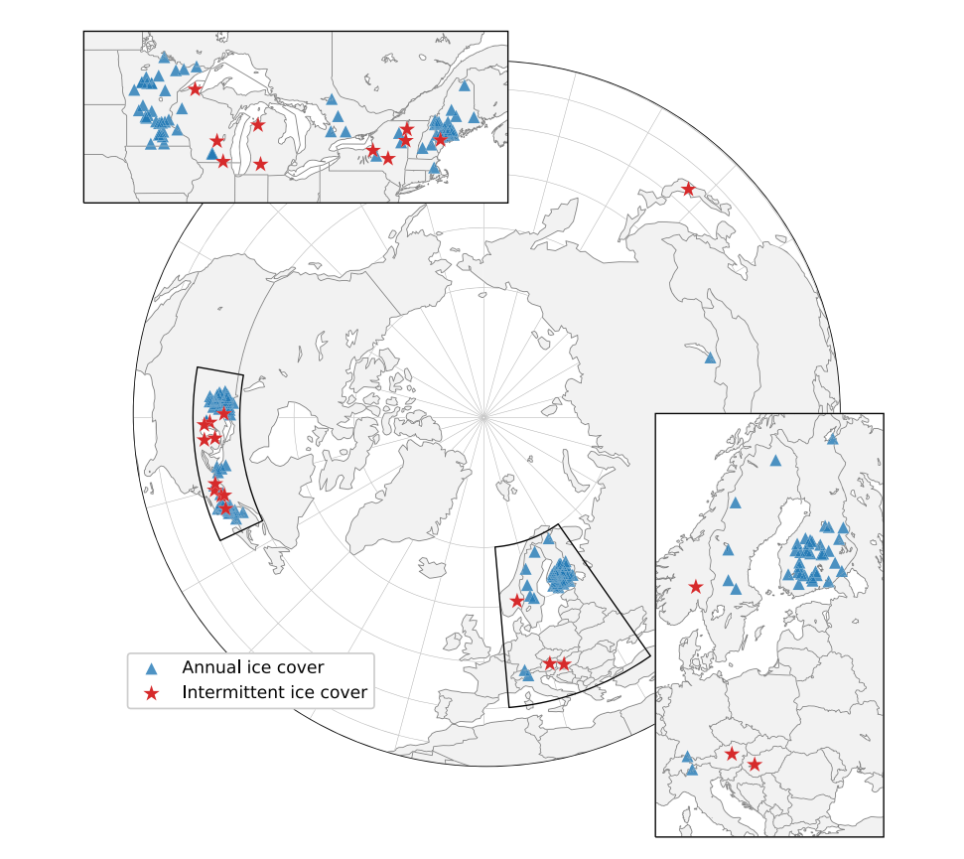
Extreme events on lake ice
Selected 122 lakes in the Northern Hemisphere
Tested the frequency of ice-free years over time
Examined the role of extreme temperatures
Filazzola et al. 2020

Slide 65
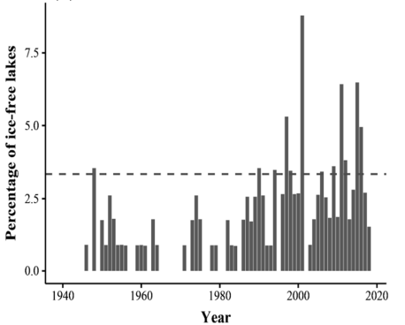
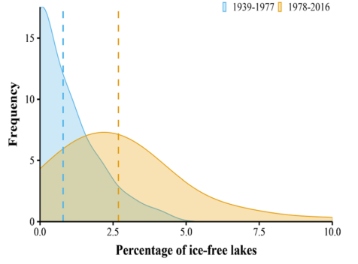
A large increase in ice-free coverage
Filazzola et al. 2020

Slide 66
Data of ice-free events
Lake | Year | IceFree | Winter air temperature
Sebago Lake | 1995 | 1 | -1
Sebago Lake | 1996 | 0 | -2.5
Sebago Lake | 1997 | 0 | -2.9
Sebago Lake | 1998 | 0 | -3.1
George Lake | 1995 | 0 | -2.1
George Lake | 1996 | 1 | -1.6
George Lake | 1997 | 1 | -0.5

Slide 67
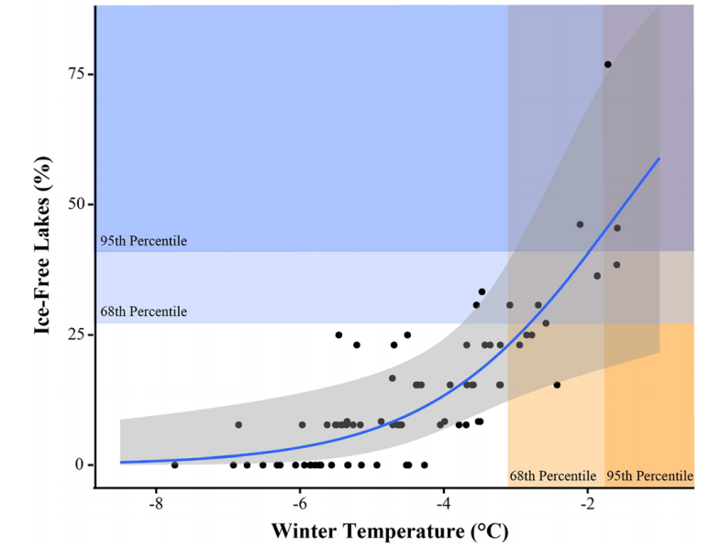
Extremes in temperature cause extremes in ice coverage
Filazzola et al. 2020

Slide 68
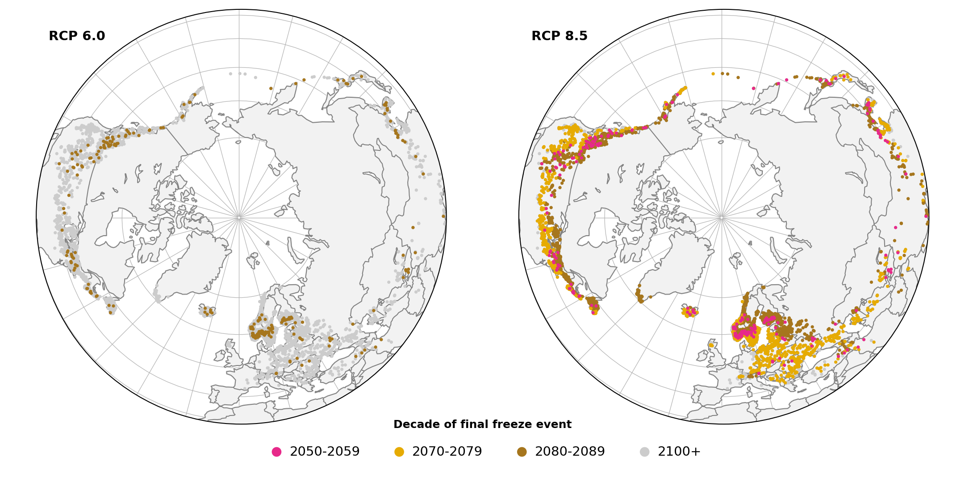
The future loss of ice coverage
Sharma et al. 2021

Slide 69
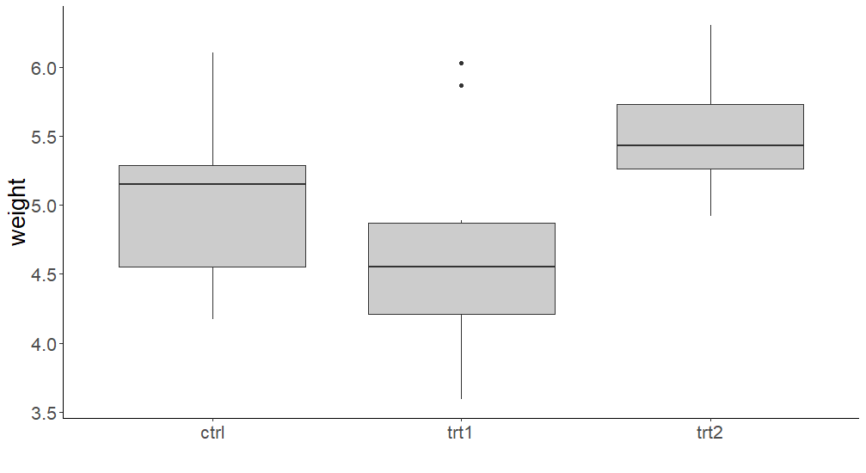
Post-hoc analyses
Part C
GLM output
χ² = 3.77, df = 2, p = 0.007
Which groups are different?
A – B
B – C
A – C

Slide 70
Post-hoc analyses
p = 0.17
p = 0.005
p = 0.37

Slide 71
Generalized linear mixed models
A GLM that includes both fixed effects and random effects
Fixed effects: predictor to test for significance; constant among observations; estimated using ML in GLMs
Random effects: predictor to account for variation among groups; estimates vary between observations; typically estimated based on a near-normal distribution
All linear models have fixed effects, but not all have random effects.

Slide 72
When to use mixed models
When trying to test for a particular effect while controlling for another variable
Examples:
Testing the effect of a blood pressure drug on patients with different initial BP values
Testing the effect of nutrient addition on plants surveyed in years with different growing conditions

Slide 73
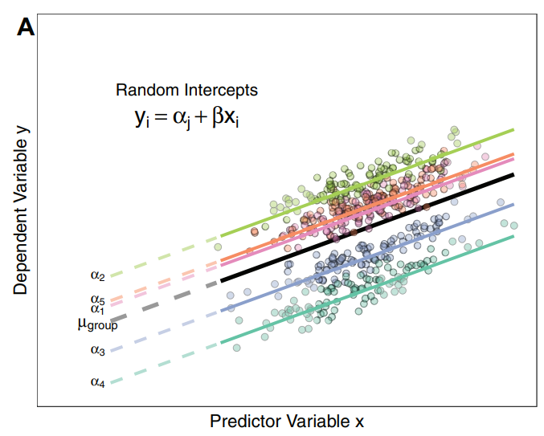
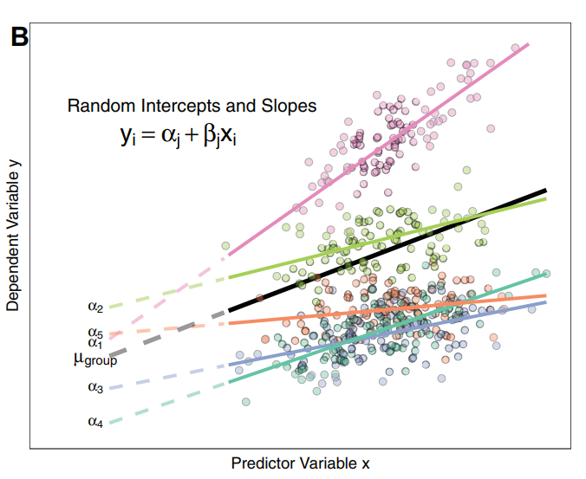
Types of mixed models
Harrison et al., 2018

Slide 74

A great introduction to mixed models
https://peerj.com/articles/4794/

Slide 75
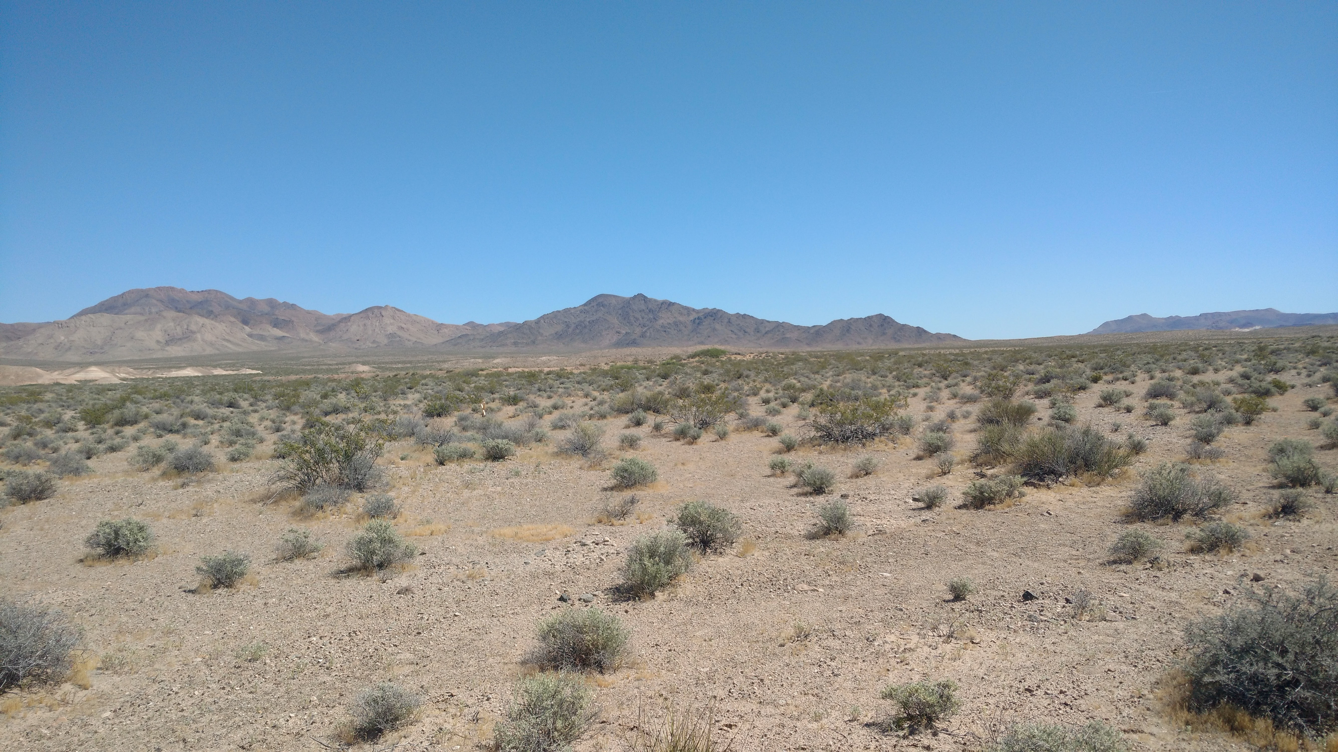
Case Study: Mixed models to estimate plant responses to aridity

Slide 76
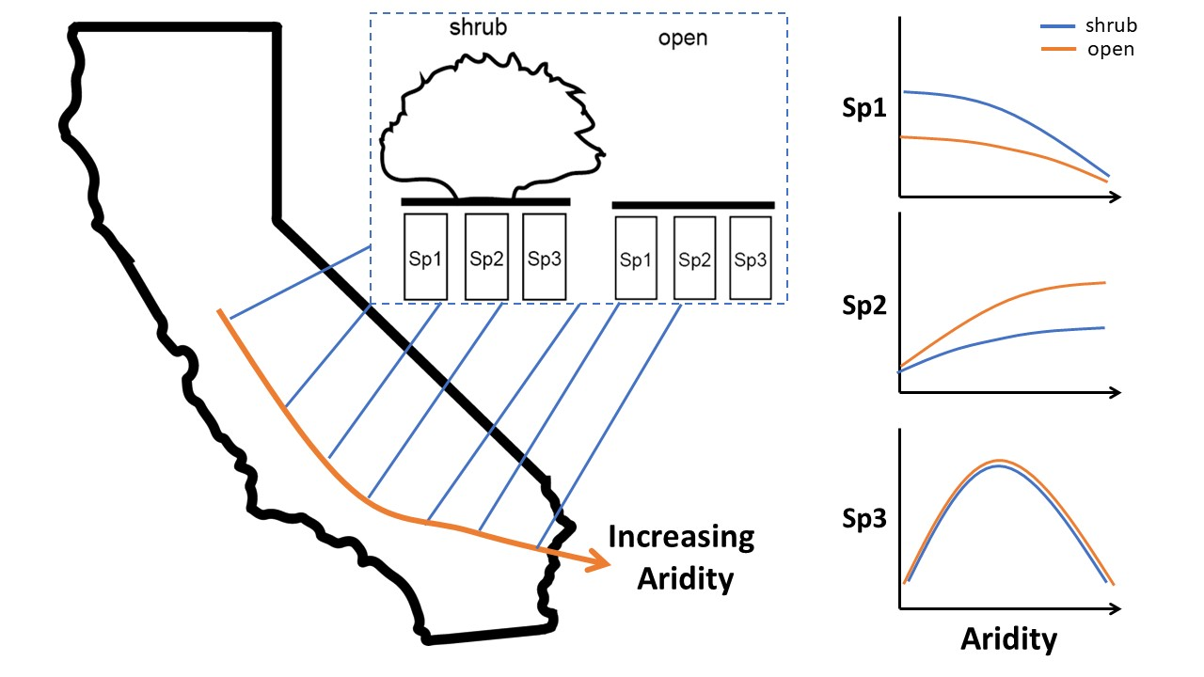


Aridity gradient to test plant interactions
Conducted in 2016
Conducted in 2017
Filazzola et al. 2020

Slide 77
Data of plant responses to aridity along gradient
PlotID | Year | Site | Aridity | Microsite | Phacelia | Plantago | Salvia
1 | 2016 | Barstow | 4.23 | open | 0 | 0 | 1
1 | 2016 | Barstow | 4.23 | shrub | 0 | 1 | 1
2 | 2016 | Barstow | 4.23 | open | 1 | 0 | 0
2 | 2016 | Barstow | 4.23 | shrub | 0 | 0 | 0
3 | 2016 | Barstow | 4.23 | open | 0 | 0 | 1
3 | 2016 | Barstow | 4.23 | shrub | 0 | 0 | 0
4 | 2016 | Barstow | 4.23 | open | 1 | 0 | 1
4 | 2016 | Barstow | 4.23 | shrub | 0 | 0 | 0
5 | 2016 | Barstow | 4.23 | open | 0 | 0 | 0
5 | 2016 | Barstow | 4.23 | shrub | 0 | 1 | 1
6 | 2016 | Barstow | 4.23 | open | 0 | 1 | 1
Filazzola et al. 2020

Slide 78
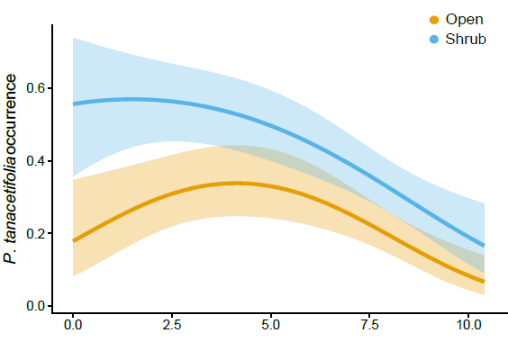
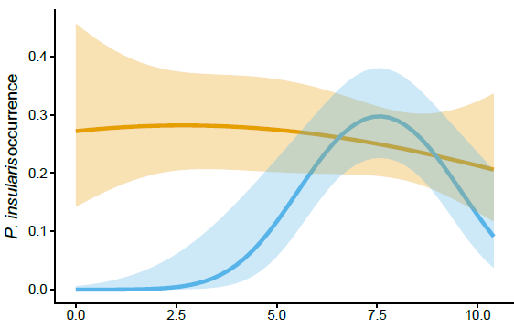
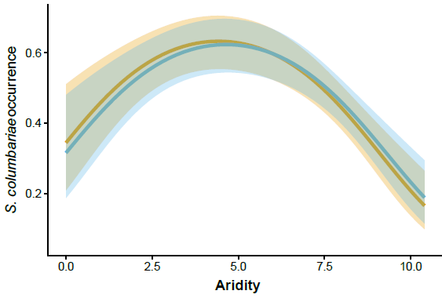
Model formulation
glmer(plantOcc ~ aridity * microsite + (1|Year), data=data, family=“binomial”)
Filazzola et al. 2020

Slide 79
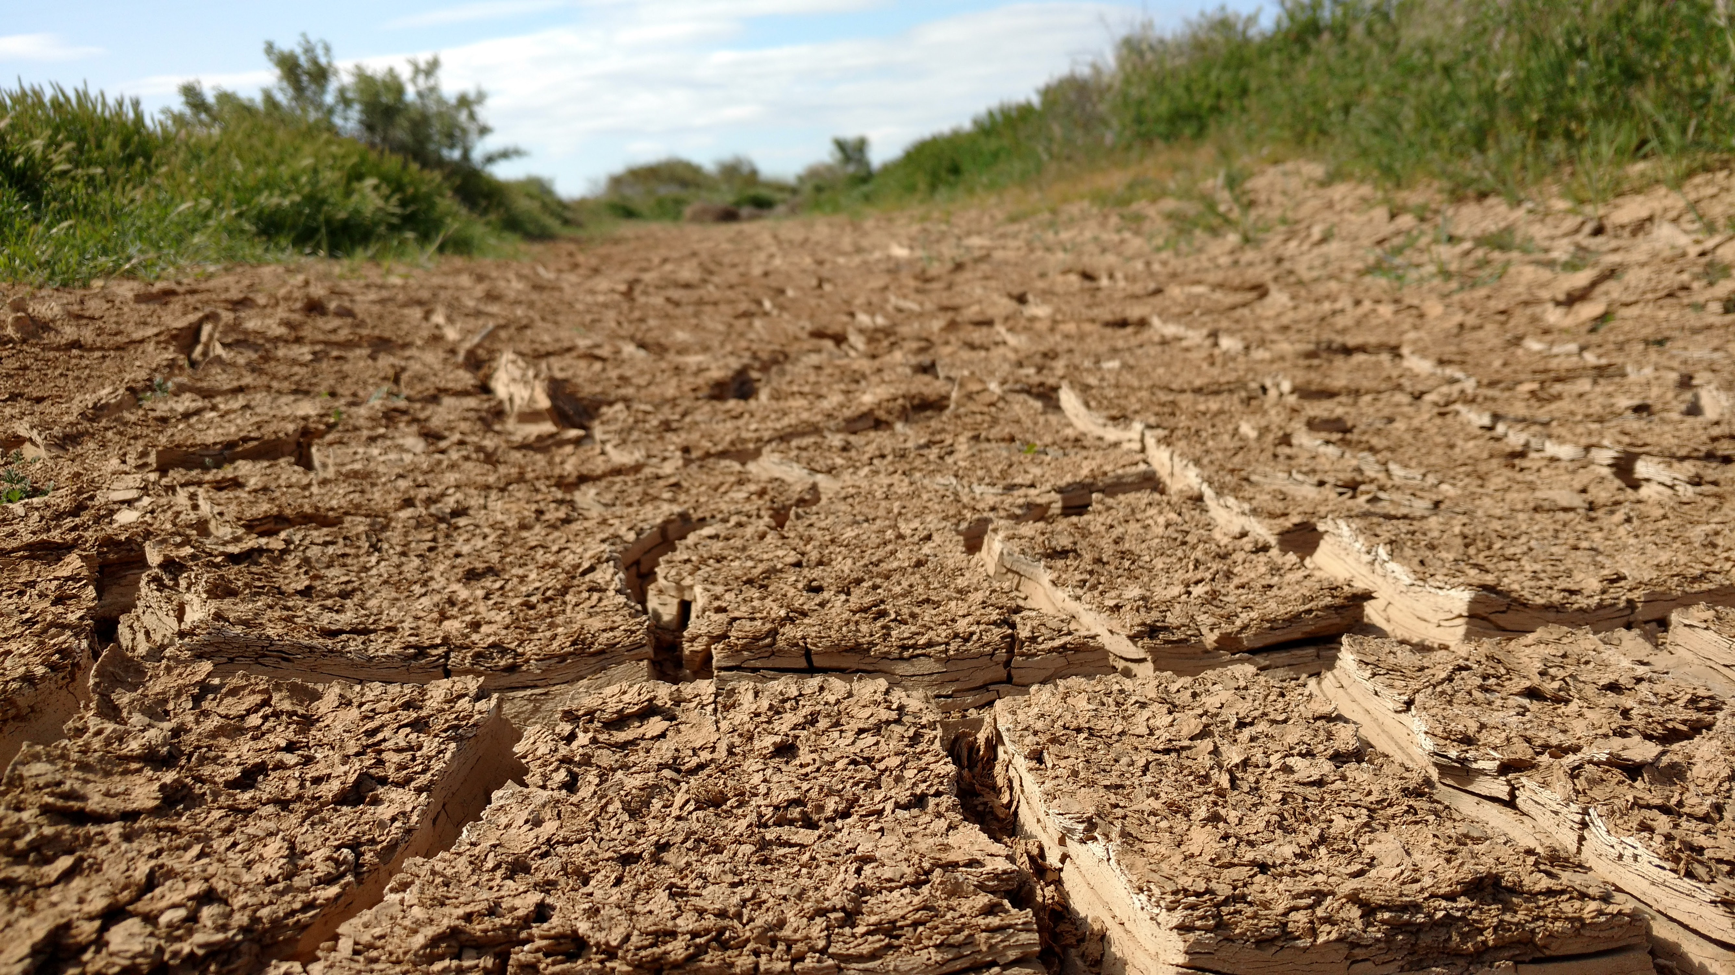
c

Slide 80


Thank you!
https://www.filazzola.info/
https://afilazzola.github.io/IntroGLM/

